Slide 1

Peloton Risk Quantification
Value Based ERm
Rajeev Dave
Qilin Xiang
Matthew E. Russell

Slide 2
Agenda
Business Introduction
Quick Statistics
Quantitative impact of baseline and the 15 risk scenarios
Company Value Change Comparison

Slide 3
Business Introduction
Peloton is an American exercise equipment company
Products:
Bikes
Treadmills
Distribution channel: Regular courier delivery
Target audience: Individuals aged above 25 preferring indoor exercise

Slide 4
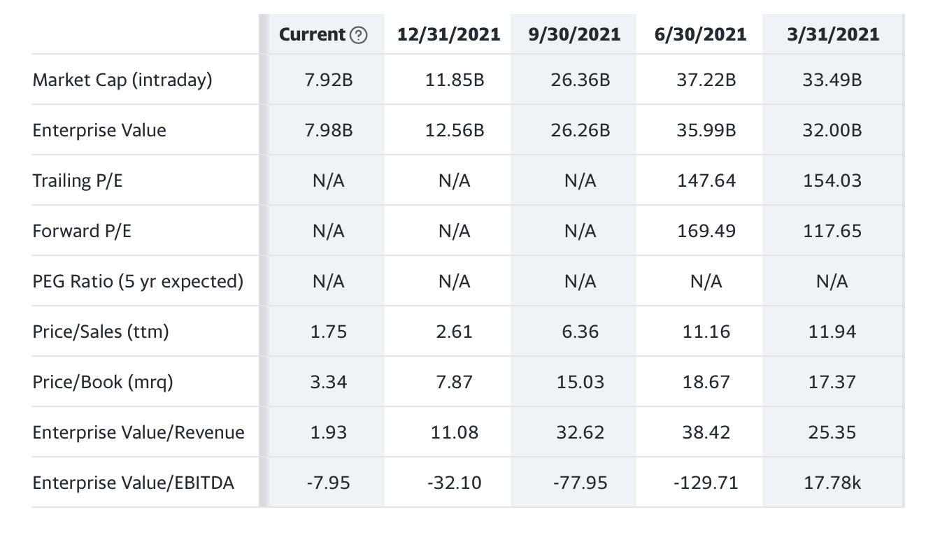
Statistics

Slide 5
Risk 1
Sr.no. | Scenario |  | COMPANY VALUE | Revenue CAGR | Net Income CAGR
1 | Baseline | Baseline model | $ 8,660.72 | 27.3% | 9.9%
2 | Very Pessimistic | Scenario Run | $ 6,370.76 | 21.2% | 0.9%
 |  | % Shock | -26.44% | -22.2% | -91.3%
 |  | $ Shock | $ (2,289.96) | NA | NA
 |  | "Under-Valuation" | 20.9% | NA | NA
3 | Pessimistic | Scenario Run | $ 7,226.80 | 21.2% | 3.5%
 |  | % Shock | -16.56% | -22.2% | -64.3%
 |  | $ Shock | $ (1,433.92) | NA | NA
 |  | "Under-Valuation" | 20.9% | NA | NA
4 | Moderate | Scenario Run | $ 8,325.47 | 27.3% | 9.1%
 |  | % Shock | -3.87% | 0.0% | -7.8%
 |  | $ Shock | $ (335.25) | NA | NA
 |  | "Under-Valuation" | 20.9% | NA | NA
Strategic-Economic risk

Slide 6
Risk 2
Sr.no. | Scenario |  | COMPANY VALUE | Revenue CAGR | Net Income CAGR
1 | Baseline | Baseline model | $ 8,660.72 | 27.3% | 9.9%
2 | Very Pessimistic | Scenario Run | $ 4,121.55 | 15.0% | -13.1%
 |  | % Shock | -52.4% | -45.1% | -232.8%
 |  | $ Shock | $ (4,539.17) | NA | NA
 |  | "Under-Valuation" | 20.9% | NA | NA
3 | Pessimistic | Scenario Run | $ 6,085.41 | 21.2% | -0.2%
 |  | % Shock | -29.7% | -22.2% | -102.3%
 |  | $ Shock | $ (2,575.31) | NA | NA
 |  | "Under-Valuation" | 20.9% | NA | NA
4 | Moderate | Scenario Run | $ 6,765.44 | 22.4% | 2.7%
 |  | % Shock | -21.9% | -17.7% | -72.7%
 |  | $ Shock | $ (1,895.28) | NA | NA
 |  | "Under-Valuation" | 20.9% | NA | NA
Operational - Disasters -Pandemic

Slide 7
Risk 3
Sr.no. | Scenario |  | COMPANY VALUE | Revenue CAGR | Net Income CAGR
1 | Baseline | Baseline model | $ 8,660.72 | 27.3% | 9.9%
2 | Very Pessimistic | Scenario Run | $ 6,111.46 | 11.9% | -6.2%
 |  | % Shock | -29.4% | -56.5% | -162.4%
 |  | $ Shock | $ (2,549.26) | NA | NA
 |  | "Under-Valuation" | 20.9% | NA | NA
3 | Pessimistic | Scenario Run | $ 6,815.20 | 16.8% | -1.2%
 |  | % Shock | -21.3% | -38.3% | -112.5%
 |  | $ Shock | $ (1,845.52) | NA | NA
 |  | "Under-Valuation" | 20.9% | NA | NA
4 | Moderate | Scenario Run | $ 8,061.55 | 23.6% | 6.1%
 |  | % Shock | -6.9% | -13.4% | -38.3%
 |  | $ Shock | $ (599.17) | NA | NA
 |  | "Under-Valuation" | 20.9% | NA | NA
Operational - Human Resources - Performance

Slide 8
Risk 4
Sr.no. | Scenario |  | COMPANY VALUE | Revenue CAGR | Net Income CAGR
1 | Baseline | Baseline model | $ 8,660.72 | 27.3% | 9.9%
2 | Very Pessimistic | Scenario Run | $ 8,462.46 | 27.3% | 9.9%
 |  | % Shock | -2.29% | 0.0% | 0.2%
 |  | $ Shock | $ (198.26) | NA | NA
 |  | "Under-Valuation" | 20.9% | NA | NA
3 | Pessimistic | Scenario Run | $ 8,604.17 | 27.0% | 9.6%
 |  | % Shock | -0.65% | -1.0% | -2.7%
 |  | $ Shock | $ (56.55) | NA | NA
 |  | "Under-Valuation" | 20.9% | NA | NA
4 | Moderate | Scenario Run | $ 8,610.70 | 27.7% | 10.7%
 |  | % Shock | -0.58% | 1.6% | 8.2%
 |  | $ Shock | $ (50.02) | NA | NA
 |  | "Under-Valuation" | 20.9% | NA | NA
Strategic-Competitor

Slide 9
Risk 5
Sr.no. | Scenario |  | COMPANY VALUE | Revenue CAGR | Net Income CAGR
1 | Baseline | Baseline model | $ 8,660.72 | 27.3% | 9.9%
2 | Very Pessimistic | Scenario Run | $ 4,058.26 | 21.2% | -15.6%
 |  | % Shock | -53.1% | -22.2% | -258.2%
 |  | $ Shock | $ (4,602.46) | NA | NA
 |  | "Under-Valuation" | 20.9% | NA | NA
3 | Pessimistic | Scenario Run | $ 4,894.44 | 22.4% | -7.4%
 |  | % Shock | -43.5% | -17.7% | -175.4%
 |  | $ Shock | $ (3,766.28) | NA | NA
 |  | "Under-Valuation" | 20.9% | NA | NA
4 | Moderate | Scenario Run | $ 6,225.67 | 24.3% | 0.8%
 |  | % Shock | -28.1% | -11.0% | -91.6%
 |  | $ Shock | $ (2,435.05) | NA | NA
 |  | "Under-Valuation" | 20.9% | NA | NA
Strategic-Execution-Product Quality risk

Slide 10
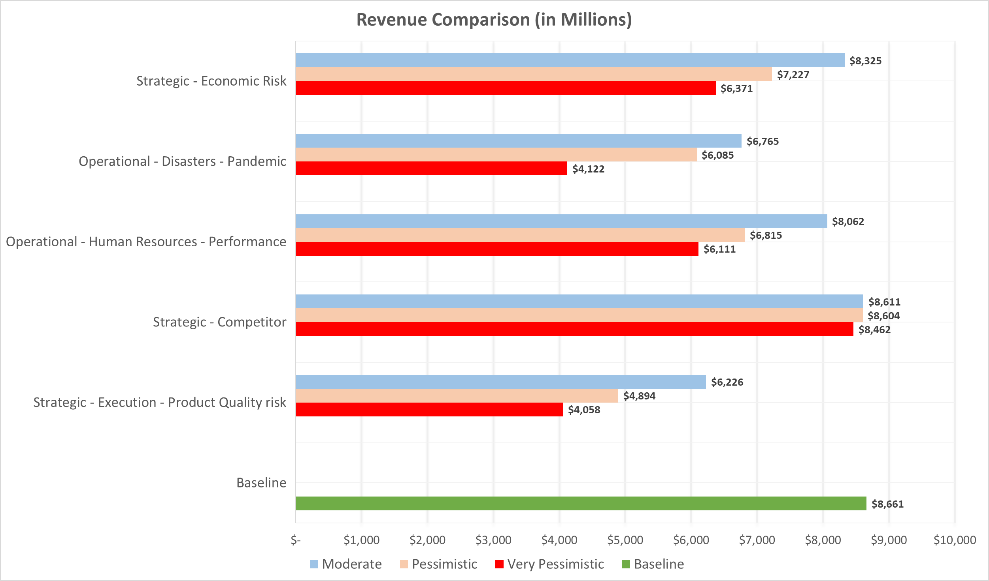
Revenue Change

Slide 11
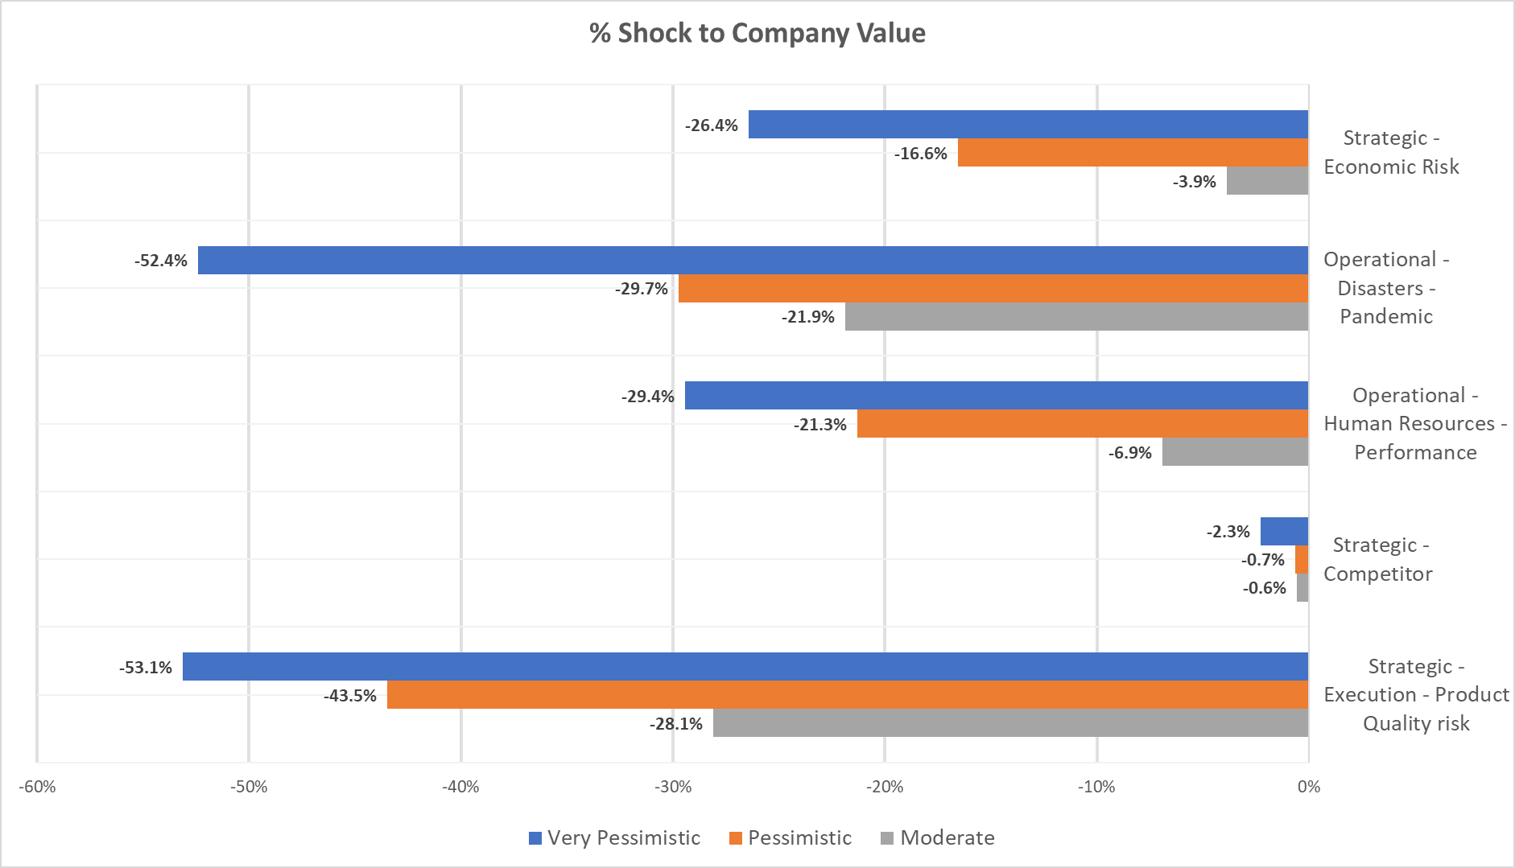
Company Value Change

Slide 12
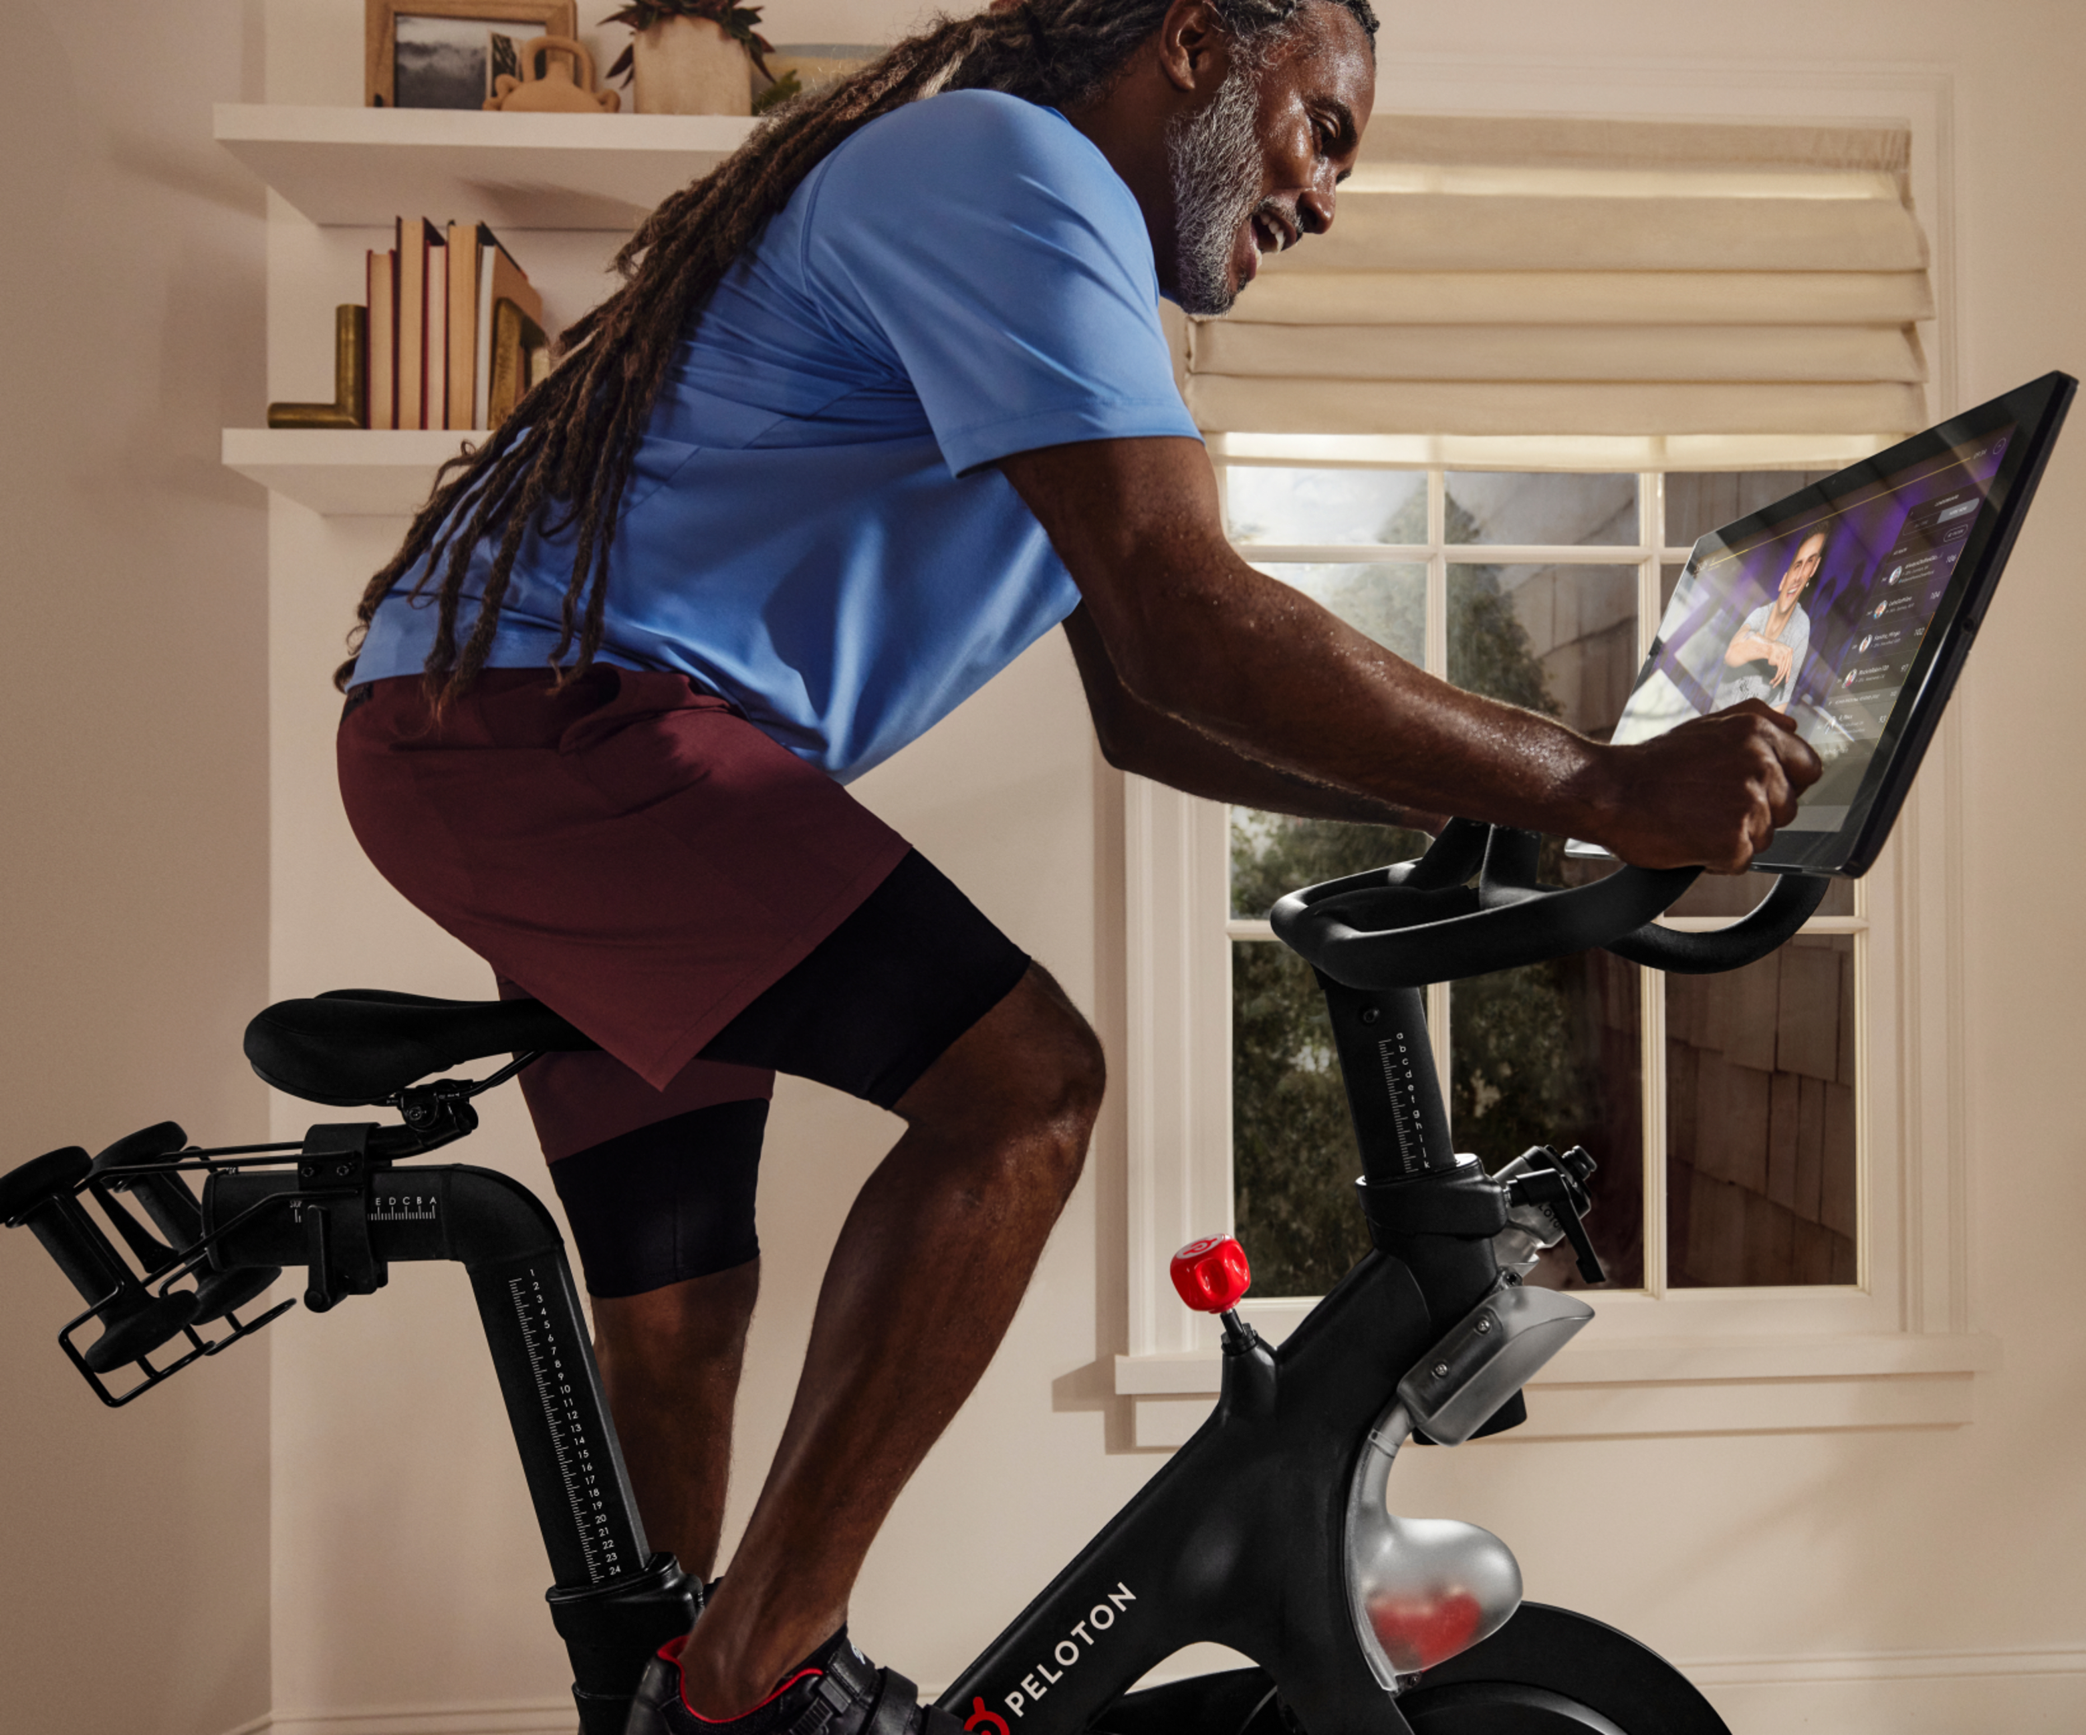
Thank you
Chunxiang Li
Xiaoyu Chen
Xiaoyue Xu
Yogesh Rohra
Zhuocheng Kong

